Slide 1
Models of Disability
Symbolic-Moral
Tragedy-Charity
Medical
Social (Impairment vs Disability)
Minority
Cultural-Affirmation

Slide 2
Common Issues Surrounding Care for Individuals with Disabilities
Many physicians focus inappropriately on their patients' disabilities rather than on their presenting complaints;
view their medical conditions or disabilities in isolation from their daily lives and aspirations;
fail to provide accommodations for sensory, cognitive, and physical impairments;
assume that a physically disabled person is also cognitively disabled, which may lead to not believing a patient when he/she reports a symptom or element of medical history;
or view the quality of their lives negatively, all of which compromise the delivery of quality health care;
a doctor may downplay the importance of a pelvic exam in a patient with a spinal cord injury, assuming she is not sexually active.
Symons, Andrew B et al. “A curriculum to teach medical students to care for people with disabilities: development and initial implementation.” BMC Medical Education vol. 9 78. 30 Dec. 2009, doi:10.1186/1472-6920-9-78

Slide 3
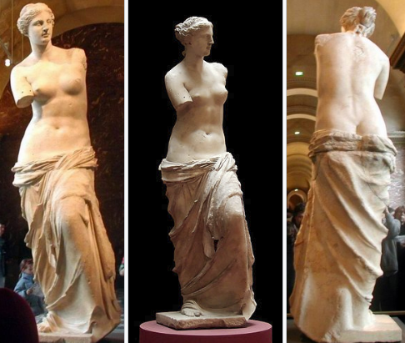
Venus de Milo
130-100 BC

Slide 4
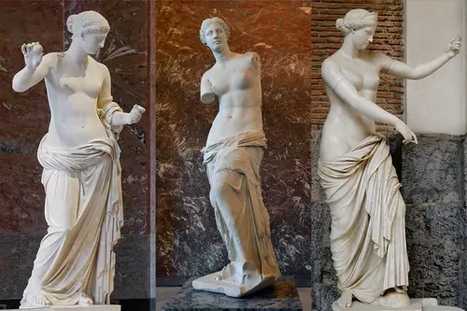
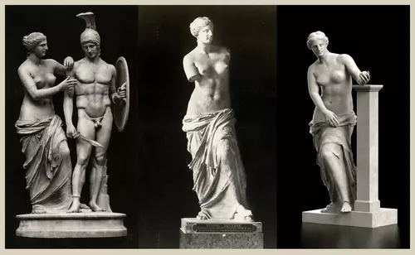

Slide 5
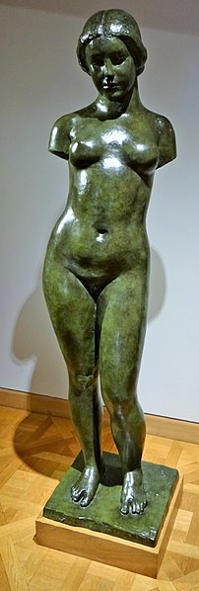
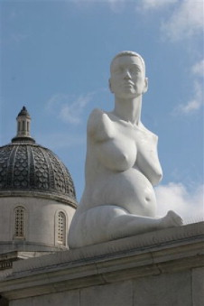
Left: René Magritte, Les Menottes de cuivre 1931
Center: Aristide Maillol, Harmonie, 1940
Right: Marc Quinn, Alison Lapper Pregnant, 2005

