Slide 1
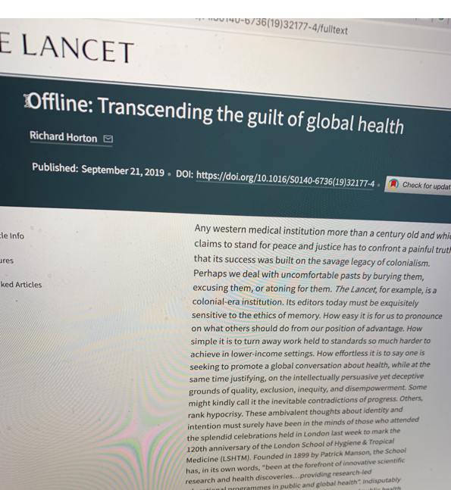
Global Health and Physician Responsibility
"Any western medical institution more than a century old and which claims to stand for peace and justice has to confront a painful truth — that its success was built on the savage legacy of colonialism.”
Richard Horton, editor of The Lancet, wrote this indictment in a column in the journal in 2019
(https://www.thelancet.com/journals/lancet/article/PIIS0140-6736(19)32177-4/fulltext)
Why?
(Note: Please see the final slide of this presentation for a list of bibliographic sources .)

Slide 2
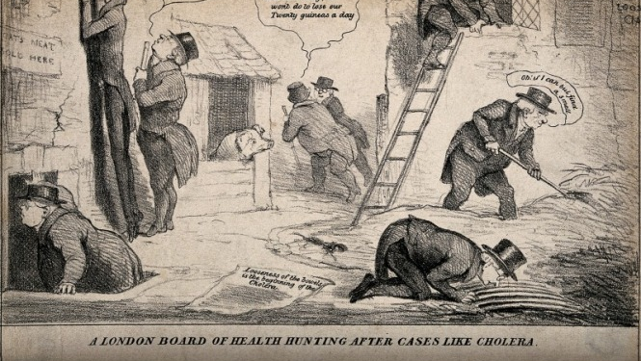
Where does the idea of global health come from?
Global health’s origins can be traced back to the field of Tropical Medicine, something that arose as an area of medical practice in the last decade of the 19th century and was tied initially (indirectly) to theories of “miasma,” the idea that rotting material, waste, filth and stagnant waterways gave rise to gaseous discharges. These gaseous discharges would cause a cloud of vapor or mist that was believed to then cause disease. It could apparently be recognized by its smell of decomposition.
- A Cholera satire, “O if I can but find a smell”

Slide 3
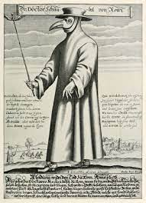
Miasma theory
Diseases and sicknesses in this view came from breathing in a miasma - the miasma cloud would infect you with a disease, often resulting in death. It was thought that these miasmas occurred exclusively in filthy places or things noticeably “off" that smelled bad like rotten food or sewage. As a theory of disease, it was prevalent in the medieval period. The masks of plague doctors that we all know even contained flowers which were supposed to keep out the dangerous miasmas that surrounded the diseased and the sick.

Slide 4
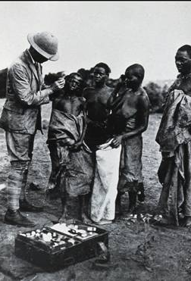
Tropical Medicine
Though the causal agent and basic means of transmission of almost every bacterial and parasitic infection of humans was identified by the latter half of the 19th century, the theory of the “miasma” likely fed 19th century ideas that the tropics were an “unhealthy” place generally, and in fact the region had long been considered an unhealthy place for Europeans to visit.
Even the designation “Tropical Medicine” is a strange piece of nomenclature since medicine is usually classified into divisions aligned to the body system involved, the age of the patient, or the disease process. Contrary to this internal classification, with its reference to the sick body, tropical medicine has been defined by an association with geography and place.
The founder of Tropical Medicine as a field, Sir Patrick Manson whose book Tropical Diseases was the field’s central text for 100 years, defined tropical diseases simply as diseases of the “warm climates.”

Slide 5
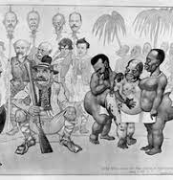
But in reality, the thing that held this category of “places of warm climate” together was that they were usually places visited by Europeans to spread Christianity, to colonise, and then exploit local natural resources, to wage war, or to conduct all three in varying degrees. Linking them all was colonialism, and the desire to extend empires. In both Britain and the United States, tropical medicine was a specialty “conceived out of the very specific needs of colonialism.”
- Wood C, editor. Tropical medicine: from romance to reality. Proceedings of a conference 12–14 December 1977. London: Academic Press, 1978.
(Image: A racist caricature of European scientists visiting Africa. The severed head on the right is that of Ronald Ross, who I’ll be mentioning in a minute.)

Slide 6
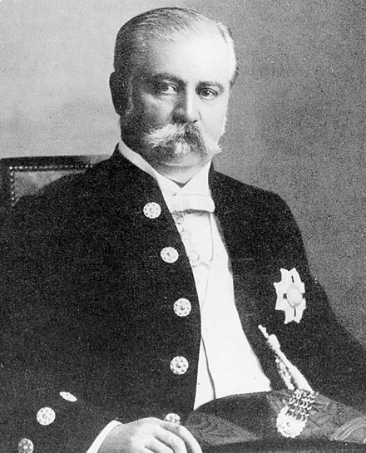
Of paramount importance in the colonial venture was the maintenance of a healthy population of the colonisers, and to a lesser extent a healthy population of the colonised, but usually only if their bodies were important as labour. The empires required commercial interests to be maintained in the colonies and the long arm of commerce was entwined into the control of tropical medicine as a discipline from its earliest days. The founder and first chairman of the Liverpool School of Tropical Medicine, for instance, was Sir Alfred Jones, ‘a great and distinguished business man having large interests in the tropics.’
(Image: Sir Alfred Jones)

Slide 7
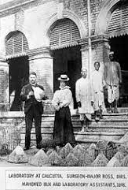
Sir Ronald Ross as example
“The European conquest and colonization of the non­European world was imbued with the dread of ‘tropical diseases’ and simultaneously sustained by the practices of settlement in these tropical colonies.”
Contagion and Enclaves: Tropical Medicine in Colonial India
____
Ross won the Noble prize for his Malaria research after leading the effort to tackle the disease, which was a leading killer of British colonists in India. In 1899, in a lecture at the Liverpool Chamber of Commerce, he argued that “in the coming century, the success of imperialism will depend largely on the success of the microscope.”
He, himself, was very much a child of empire. Born in India, he later worked there as a surgeon in the imperial army. When he used a microscope to show how a dreaded tropical disease was transmitted, he would have realised that his discovery promised to safeguard the health of British troops and officials in the tropics. Something that would in turn enable Britain to expand and consolidate its colonial rule.
This is one illustration of how the efforts of British scientists were intertwined with their country’s attempt to conquer a quarter of the world.

Slide 8
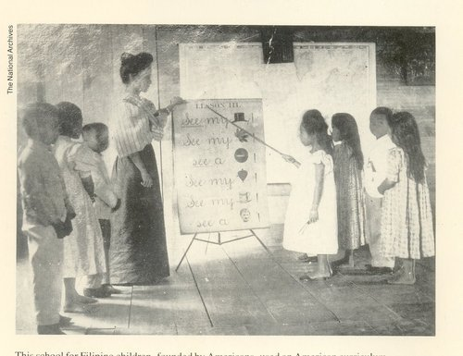
Another example, the Philippines
Ross’ comments also show how science could be used to argue that imperialism was morally justified because it reflected British goodwill towards colonised people.
Examples like these can be found throughout the colonized world. For instance, soon after American forces took over the Philippines in 1898, Dr. Victor G. Heiser was appointed Philippine director of health in 1902, a position in which he would remain until 1915.
In his words, “it had to be understood that ‘the health of these people is the vital question of the Islands. To transform them from the weak and feeble race we have found them into the strong, healthy and enduring people that they may yet become is to lay the foundations for the successful future of the country.’”
- Colonial Pathologies: American Tropical Medicine, Race, and Hygiene in the Philippines
The result, again, is effectively a justification for foreign, in this case American, occupation. Like education, this could function as a colonial tool.

Slide 9
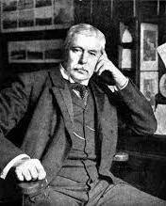
Tropical medicine in its origins was quite clearly more about helping colonizers on the ground rather than the people they colonized. Between 1866 and 1890, the founder of the field that I mentioned earlier, Patrick Manson, worked in Asia. While he did a small amount of work attending to the needs of the local population, even he predominantly cared for Europeans who were involved in commerce there.
In 1890 when he returned to England, he established himself as an expert in tropical medicine, and was was appointed Medical Adviser to the Secretary of State for the Colonies in 1897.
He then turned tropical medicine into a teaching field. He pushed through an initiative whereby the Colonial Medical Service medical officers would have instruction in tropical medicine, hygiene and climatology and in 1899, The London School of Tropical Medicine was established.
(Image: Patrick Manson)

Slide 10
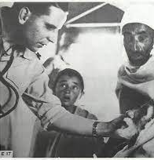
Schools of tropical medicine were soon established in Germany, Belgium, Italy, India (while under British rule), and the United States, with Harvard’s school of tropical medicine known for its connections to commercial enterprises in tropical regions.
The new discipline proved useful during WWI, especially in the Middle East. After the devasting losses to yellow fever in the Spanish-American war, it also allowed the Americans to solve the yellow fever problem, leading to the completion of the Panama canal.
“Thus in commerce, colonialism and conflict were the credentials of tropical medicine established. It maintained its influence throughout the colonial era, with the various schools and institutes producing thousands of doctors equipped for colonial service.”
Andrew D S Gibson, “Miasma Revisited: The Intellectual History of Tropical Medicine.”

Slide 11
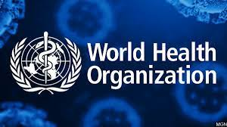
In the 20th century, global health has taken a different form, with major changes occurring especially after the Second World War and decolonization. The World Health Organization (WHO), for instance, responsible for international public health, was founded in 1948, stating as its objective “the attainment by all peoples of the highest possible level of health.” Their eight goals for the new millennium released in 2000 were:
Eradicate extreme poverty and hunger
Provide universal primary education
Improve gender equity and empowerment of women
Reduce childhood mortality
Improve maternal health
Combat HIV/AIDS, malaria and other disease
Promote environmental sustainability
Develop Global partnerships for development

Slide 12
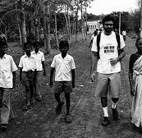
So, what problems remain? A few, in one doctor’s view
Abraar Karan, an internal medicine resident in the Hiatt Residency in Global Health Equity at Brigham and Women's Hospital and Harvard Medical School, and who has also worked in rural India, wrote on this subject for NPR and has a couple of relevant thoughts.
“If you are from a high-income country working in a low-income setting, and you don't think and rethink about this topic often, there is a good chance you are contributing to the problem.” He points to “drop-in” trips in which he himself has participated, too short to do any sustained good, that were reminiscent of “the colonial era: Western doctors traveling to unknown territories to help less-educated locals.” He also notes that the local population “had no recourse against us if we were to behave inappropriately — no way to hold us accountable. There was nothing they could do about the group of foreigners who came, saw and ultimately did not stay or return. Certainly those of us working on the program were better than brutal colonizers. But were we that different in the very basic power dynamics between light and dark skin? Between wealthy and poor? Moreover, the nature of our mission perhaps confirmed the worst fears of the local community: We would not be coming back there.”
The primary benefit of this work, he admits, was to his CV.

Slide 13
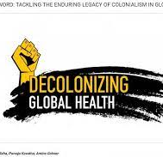
“The relationships within global health are still heavily (and falsely) dominated by the idea that the Global North is ‘helping’ the Global South. The opposite is rarely acknowledged or encouraged in any meaningful way. Even when doctors from impoverished countries are brought to wealthy countries as part of exchange programs, it is under the assumption that they are coming to learn from us….
I do not write this to say that there is no role for doctors from high-income places to work in global health. There certainly is, and in fact, it is more than a role. It is a responsibility. Part of the legacy and inequity of colonialism is that we in the Global North benefit from access to new technologies, drugs, equipment and money as well as sanitation, electricity, transportation. The list goes on.
But that is not because we are any better than doctors in poor countries. It is because our leaders have collectively and systematically done everything possible to make sure those countries stayed less economically empowered than our own for centuries.
Our role in global health as practitioners from wealthy countries is then not a practice in which we are ‘helping’ poor countries; it is one in which we are hoping they can forgive us for having decimated them in the first place.”

Slide 14
Part 1: Discussion on what GH means to you?
Some introductory guiding questions for your groups:
  Why should physicians concern themselves with the global? Or Any reasons why we should not bother about GH?
  What assumptions might physicians carry with them to sites abroad that work against their best intentions?
  How might global health education inflect the local, particularly in relation to minority and/or disenfranchised populations?

Slide 15
“Culture in Medicine: An Argument Against Competence”
1A) How does the author explain the ideal of cultural competence in medical training in its current form? What is it meant to accomplish? How does the author begin to problematize our assumptions about culture as something in which the physician can gain competence as they would a technical skill?

Slide 16
Against persistent race and ethnicity-based health disparities, breakdowns in communication between patient and provider, and issues of cultural difference around delivery and acceptance of healthcare, “cultural competence” is often offered as the solution. It’s meant to create increased sensitivity, humility, and awareness in the clinical context.
What’s the problem with this? 1) It reduces human complexity to a set of cultural traits, equating race & ethnicity to “culture” at the exclusion of other categories, often producing and reinforcing the very stereotypes it was meant work against. 2) It ignores the structural determinates of healthcare, ‘blaming the victim,’ so to speak. For example, Abraar Karan, the doctor I mentioned at the end of my opening presentation, talks about a short trip he took to the Dominican countryside. He notes that while they were working to treat coughs, colds, diarrhea, and fevers, they could do nothing to treat all of the reasons contributing to these diseases: poverty, the lack of paved roads and latrines, food insecurity, insufficient education, and even political disenfranchisement (if people can’t vote in fair elections, how can they hope to impact government healthcare decisions?). None of these factors have anything to do with “culture,” but are all concretely structural. 3) There’s no actual proof that training in cultural competency meets any of its stated objectives.
What the author begins to question here is “the idea that competence in the culture of the patient can and does offset power inequities” (542). Can a physician actually claim “competence” about the identity, norms, lifestyle, or ‘culture’ of a patient, as one would about biology or physiology? Historically – and here this connects to global health’s entwined history with colonialism – increased knowledge about cultural others has “just as often led to more, not less, inequality, abuse, and exploitation of populations from culturally non-dominant backgrounds” (542).

Slide 17
1B) Is cultural competence part of our medical education curriculum? What form does it take (eg: formal teaching/assessment or informal, experiential learning)?
What are your thoughts?
Usually informally from experiential learning and watching/ role modelling
Subconsciously we take in more than we are aware of. Eg: Expecting a Malay lady if we have a grand multiparous patient (5 or more births)

Slide 18
“Culture in Medicine: An Argument Against Competence”
2A) What does the author hope to accomplish by shifting focus and unpacking what we mean by “competence” instead of thinking about culture as is generally the case? Why is the idea of an episteme important here?

Slide 19
Within the phrase “cultural competence,” it’s actually the idea of “competence” that’s really key within the clinical interaction, though we rarely stop to unpack what significance competence as an idea might contain.
What does this shift in focus accomplish? For starters, it allows for a different question to be asked: “By displacing the critique from culture to competence, the intention is to shift the analytical lens from a focus on what and who is known (that is, what are Hispanics, African Americans, Asians, or Whites like, and why?) to the lens through which we come to ‘know’ and represent an Other in clinical medicine and with what effects” (543). We no longer ask about the patient as object, but rather how we have come to understand them (and with what biases) and what the consequences of that might be.
Competence, measured by “training,” “certification,” and “authorized knowledge,” has high symbolic value for physicians and medical students, legitimating scientific authority and social prestige. Yet the suggestion here is that “a framework of competence…facilitates a kind of professional hubris that too easily dismisses and disparages epistemic diversity even as it recognizes racial, ethnic, and linguistic heterogeneity” (543).
What is an episteme in the sense used here? Taken from French philosopher Michel Foucault, this refers to “the ‘unconscious’ structures underlying the production of scientific knowledge in a particular time and place – in other words, the ‘epistemological field’ which forms the conditions of possibility for knowledge in a given time and place. It’s often been compared to T.S Kuhn’s notion of paradigm” (https://michel-foucault.com/key-concepts/). “It defines not only what is welcomed and acceptable within the scientific field, but also the kinds of knowledges and understandings that are excluded as non-scientific” (545). Competence, as an episteme, is “shaped both by clinical priorities based on biomedical knowledge and by the neoliberal imperatives of standardization, metrics, measurements, accountability, efficiency, and expertise” (545). Current pedagogies focus on teaching students how to integrate and apply cultural knowledge as they would scientific knowledge, but should this be the framework for less scientific domains in the clinic like patient culture?

Slide 20
2B) Do we sometimes use frameworks to explain patients’ health behaviors based on their cultural and social background? When do these frameworks help and when do they not?
What are your thoughts?
Eg: Biopsychosocial model
Pros: Help to identify risk factors within certain groups
Cons: Packaging patients into boxes based on the framework and putting less effort in understanding the health attitude and behavior as they ‘fit into the framework’. Culture to explain their behaviour rather than their using their experience or social circumstances. Looking at them as a race or group that needs help rather than as a person. Eg: perhaps the Indian man remains an alcoholic as less effort was spent discussion possible interventions with him? And perhaps no one addressed his history of loneliness after his wife’s death, which is the main trigger for the alcohol issue.

Slide 21
“Culture in Medicine: An Argument Against Competence”
3A) The author suggests that we stop thinking about the medical practitioner as a “blank slate” and think instead about how healthcare practitioners do understand themselves and others. What would be the significance of this move? How would it change our approach?

Slide 22
“The prevailing assumption…is that physicians do not know about cultural others and, therefore, need to be educated about them” (546). Yet, we can see even in the history of Global Health’s origins, it’s not the case that health professionals have known nothing about their cultural others, and are blank slates simply waiting to be filled with information. Global Health is in fact founded on the collection of knowledge about cultural others, often used to questionable (colonial) ends. A knowledge deficit isn’t the problem.
What if we think instead about what we do know and how we have come to know it? The article gives an example from the US context. What might be the pitfalls facing White medical practitioners when it comes to black patients? They inhabit a particular media universe filled with images of black entertainers, athletes, and criminals, all leading to extensive stereotypes and prejudices. They might claim to not know anything about their black fellow citizens, but in fact they already have a whole store of pre-existing ideas that affect their interactions.

Slide 23
3B) How are healthcare worker “not blank slates”? What biasness do we have? Have we unknowingly/subconsciously used a patient’s race/ culture to explain certain health behaviors? How may this impact communication, understanding and management of our patients?
What are your thoughts?
Expecting Indian or Malay to be non-compliant to diabetes control or associating patient’s pain tolerance with their race or associating gambling addiction with the Chinese race
Healthcare inequity in marginalized groups in US
when we head to another country to work, having a pre-conceived notion about the culture of the people and unknowingly adopt a superior stance that we are bringing Western medicine to a “backward” setting

Slide 24
“Culture in Medicine: An Argument Against Competence”
4A) The author outlines a number of historical examples where pre-existing cultural knowledge has led to troubling results. What do we think of these examples? Can we think of any other instances where racial and cultural knowledge has been conflated with scientific knowledge in a way that has led to harm?

Slide 25
- We assume that “increased cultural competence will lead to more humble, ethical and humane practitioners and thus to happier patients….In fact, however, history has too often shown the opposite when it comes to relations between dominant and oppressed populations. Increased knowledge about cultural and racial others has historically been used to oppress, subjugate and exploit non-Western and non-dominant populations rather than treat them in more ethical and humane ways. Indeed, cultural knowledge in the colonies, on the slave plantations, in prisons and war camps, during the Cold War, and in variety of other circumstances and places, including communities of color in the US, has served to solidify the hegemony and authority of those in power. The emergence of Area Studies, the invention of the Peace Corps, and myriad other foreign policy strategies have used cultural knowledge to attain cultural, social, political and economic dominance in other countries. This includes efforts by the US military to become more culturally competent as a way of winning the ‘hearts and minds’ of potentially hostile foreign populations….Medicine has not been excluded from this dynamic,” and has arguably been one of the most important ‘tools of empire’ (546-7).
- Going back to the previous question, “contrary to the idea that medicine suffers from cultural ignorance, the history of medicine shows that biomedicine has always relied on some form of pre-existing cultural knowledge about those populations to be experimented upon, researched, and treated” (547). Examples: Saartjie/Sarah Bartman; experimentation on Jews in Auschwitz; syphilis experiments on Guatemalan peasants and African American men in Alabama; Henrietta Lacks etc. etc. (547).
- The “dehistoricised and uncritical version of cultural competence, which assumes the need to redress the epistemic shortcomings of physicians with regard to patient culture while ignoring the ways in which the biomedical establishments and its practitioners have always-already relied on received racial and cultural understandings, reinforces characterisations of biomedicine as both scientifically and socially neutral and beneficent while obscuring the ways in which medical dominance has historically depended on gathering and deploying cultural knowledge, or ‘competence,’ to establish and maintain its hegemony” (548).

Slide 26
4B) The author outlines a number of historical examples where pre-existing cultural knowledge has led to troubling results Can we think of examples in medicine, both when practicing at home or in an overseas setting, in a low- and middle-income country?
What are your thoughts?
perhaps, making assumption of prevalent infections in villages in a LMIC and prescribing antibiotics freely, leading to the spread of resistance
having a presumption that a population is ‘backward’ and deciding to teach them how to brush teeth or wash hands; not harmful but may be seen as derogatory
allegations of WHO officials taking advantage of the local girls in Congo; https://www.thenewhumanitarian.org/2021/05/12/exclusive-new-sex-abuse-claims-against-ebola-aid-workers-exposed-congo)
Western based medical education system in a non-Westernized country without customization of the curriculum

Slide 27
“Culture in Medicine: An Argument Against Competence”
5A) It’s been argued by women-of-color feminists, critical race scholars, and post-colonial theorists for decades that the problem has never been that dominant groups don’t know marginalized groups, it’s how they have known them that’s been the problem. What does this mean? How might we get around the problem that’s described here and approach global health more ethically?

Slide 28
An example of this problem of how is articulated by one black feminist as follows: “The black woman’s critique of history has not only involved us coming to terms with ‘absences;’ we have also been outraged by the ways in which it has made us visible, when it has chosen to see us.” What this means is that black women’s lives have simultaneously been erased and made visible according to a masculine, white, Western world view, because these have been the people with the authority to define the categories, rules, values, and symbols used to represent historically marginalized groups.
What’s at stake here is the ability to shape the episteme, to label certain practices as “unscientific,” “irrational,” “illogical” against the norm of Western biomedicine (549).
Something called “epistemic injustice” can also be a problem here. “When biomedicine appeals to phenotype [i.e. race] or demographics to understand patient diversity, it can lead to stereotypes that effectively erase the patient by re-presenting her through an identity, a voice and a way of being that correspond more closely to discourses and ideas about her cultural identity than to the cultural differences or similarities that are actually at work. This kind of erasure can also happen based on a particular way of hearing the patient…when students learn to listen for only clinically relevant information. When a person’s thoughts, beliefs, ideas, and ways of being are disparaged as illogical, irrational, or unscientific, or when a person is not allowed to be present in her full human complexity,” this is epistemic injustice (549).
The challenge for the physician is to learn to hear and understand differently, without viewing the patient as having a “credibility deficit” (550). (The credibility gap is something seen when patients are unable or unwilling to adopt the biomedical worldview and are considered to lack credibility as a result.)

Slide 29
5B) “…it’s how they have known them that’s been the problem. What does this mean? How might we get around the problem that’s described here and approach global health more ethically?”
Can we think of similar examples in our local setting? Can we think of such examples when conducting GH work in an overseas setting?
Keen to hear your examples
Eg: Attributing big families to being Malay and spending less time talking about contraceptive methods.
Eg: Expecting lower resource setting= poor health literacy or poor health behaviors by Western medicine standards. (eg: In Nepal, finding better health literacy and acceptance with regards to birth control methods)

Slide 30
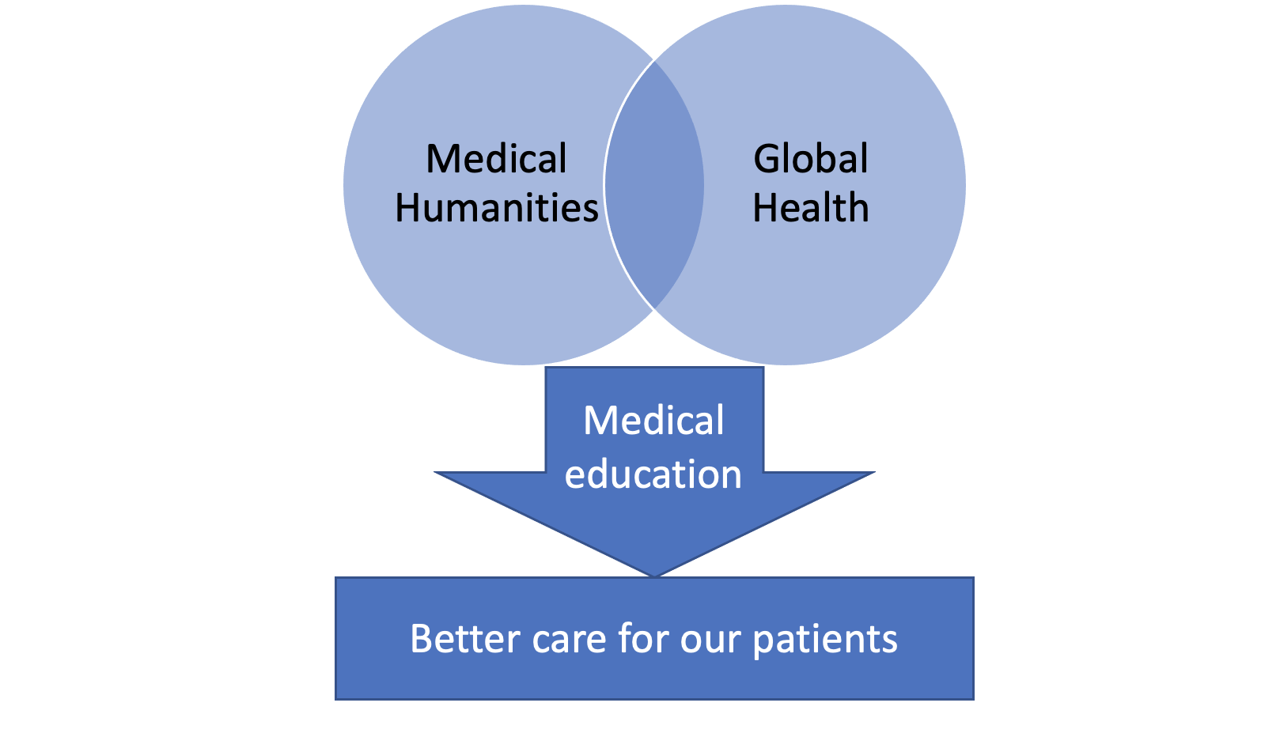
What is Global Health?
Koplan et al- '….an area for study, research, and practice that places a priority on improving health and achieving health equity for all people worldwide'. ... Global health is focused on people across the whole planet rather than the concerns of particular nations.’

Slide 31
This Presentation Contains Excerpts from the Following Sources:
Anderson, Warwick. Colonial Pathologies: American Tropical Medicine, Race, and Hygiene in the Philippines. Durham: Duke University Press, 2006.
Bhattacharya, Nandini. Contagion and Enclaves: Tropical Medicine in Colonial India. Liverpool: Liverpool University Press, 2012.
Gibson, Andrew D. S.. “Miasma Revisited: The Intellectual History of Tropical Medicine.” Aust Fam Physician. 2009 Jan-Feb;38(1-2):57-9. PMID: 19283238. https://pubmed.ncbi.nlm.nih.gov/19283238/
Hester, Rebecca J. “Culture in Medicine: An Argument Against Competence.” in The Edinburgh Companion to the Critical Medical Humanities, edited Sarah Atkinson, Jane Macnaughton, Jennifer Richards, Anne Whitehead, and Angela Woods, Edinburgh: Edinburgh University Press, 2016, 541-558.
Horten, Richard. “Transcending the guilt of global health,” The Lancet. VOLUME 394, ISSUE 10203, P996, SEPTEMBER 21, 2019 https://www.thelancet.com/journals/lancet/article/PIIS0140-6736(19)32177-4/fulltext
Karan, Abraar. “Opinion: It’s Time to End the Colonial Mindset in Global Health.” NPR. December 30, 2019. https://www.npr.org/sections/goatsandsoda/2019/12/30/784392315/opinion-its-time-to-end-the-colonial-mindset-in-global-health
Roy, Rohan Deb. “Decolonise Science – Time to End Another Imperial Era.” The Conversation. April 5, 2018 https://theconversation.com/decolonise-science-time-to-end-another-imperial-era-89189
Wood C, editor. Tropical medicine: from romance to reality. Proceedings of a conference 12–14 December 1977. London: Academic Press, 1978.

