Slide 1
Reading the Body, Writing the Body
Chiam Min
Lawrence Lacambra Ypil

Slide 2
Writing the Body: Healing and Words
Every patient is a poet;
every doctor, a writer.

Slide 3
The Doctor As Writer
The Role of Language
Writing Beyond the medical record.
  The Role in Medical Education
  The Role in Medical Practice

Slide 4
The Doctor as Writer
What makes doctors good writers?
Observation
Analysis, Detachment
Wealth of experience, exposure to different kinds of people
Are there disadvantages?

Slide 5
Writing and Medical Education
Some questions to consider:
What role can writing play in your classroom?
What role can writing play in your practice? (Journal/reading)

Slide 6
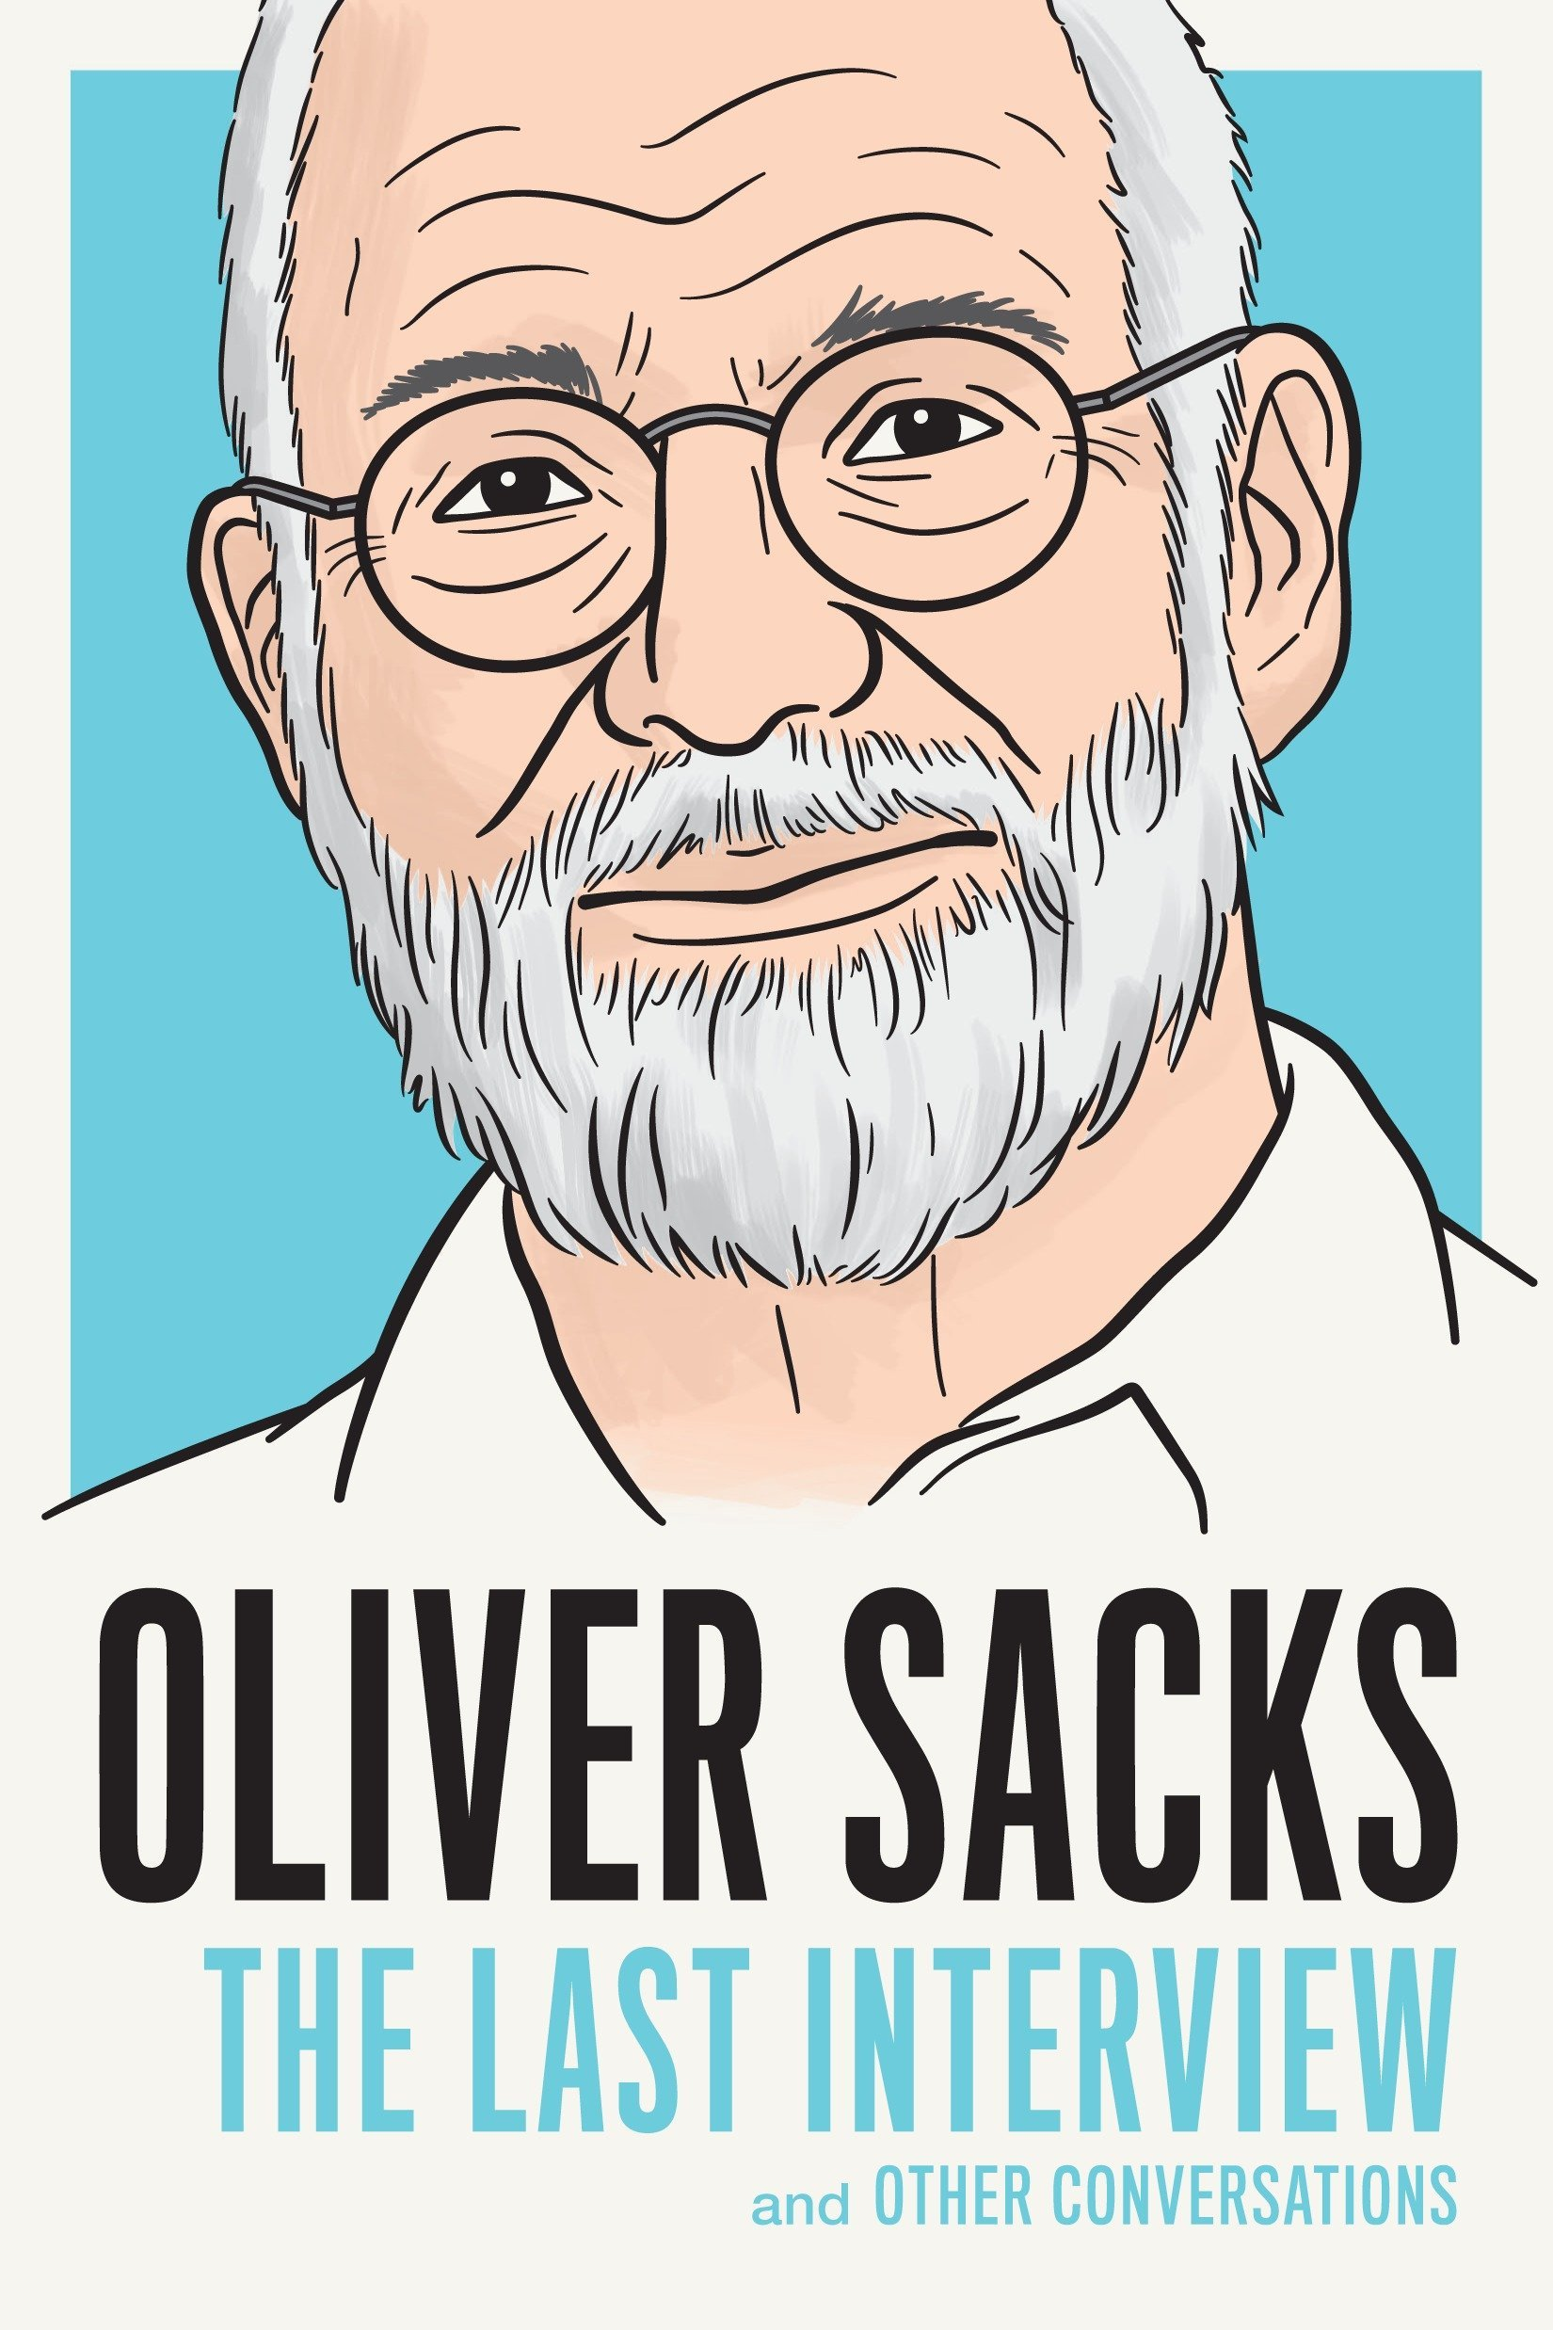
Writer in Focus
The doctor as creative witness.
Neurologist
Awakenings
A good case study of what it means to be a doctor-writer
Other examples: Anton Chekhov, William Carlos Williams, Arturo Rotor

Slide 7

Essays that are based on medical case studies

Slide 8
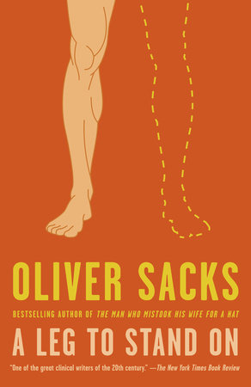
The doctor as patient

Slide 9
Writing Medicine-ly
Conventions of fiction, the way of storytelling
Conventions of medicine: observation, accuracy
Writing creatively ---- going beyond what might be put in a medical record.
What might be usually left out?
How might this be interesting to a friend / acquaintance (audience)
Is this just about the patient or is this about something more?
Writing FROM UNCERTAINTY. WRITING AS DISCOVERY.

Slide 10
Activity: Writing the Body (7 mins)
Option 1: Case studies of a different kind
Write about an interesting patient and explore why you think you remember them. The reason may not be clear, but the writing can choose to explore this.
Why do you remember them? Where does the memory of this patient lead you to? What are you really writing about? “For some reason, I remember___________ “
Experiment with tone and style. Use a voice you would never use in a medical record. Ruminate, reflect, bring in humor, make this patient memorable to us too.
Option 2: The doctor as patient
Write ala Oliver Sacks. Describe a moment when you were ill. Describe it as a doctor would. But also describe it as a writer would. Mix your sense of writing style with your knowledge as a doctor. Illuminate an aspect of illness that you realized during this experience.

Slide 11
Writing the Body: (sharing session) 15 mins)
Breakout rooms:
Each member of the group picks and shares an excerpt of the writing exercise. (Pick a section you are proud of. 4-6 sentences. Read out loud. ) Be mindful of time so that everyone gets to share a bit of their work.
After everyone gets to share their excerpt, as a group share about what you found enjoyable and enlightening about writing it. You can also share what was difficult!
Bring up questions you can explore as a group or when we regroup.

Slide 12
Conclusion: Healing and Words

