Slide 1
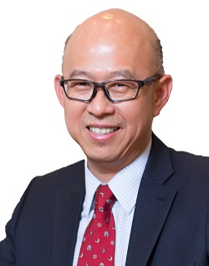
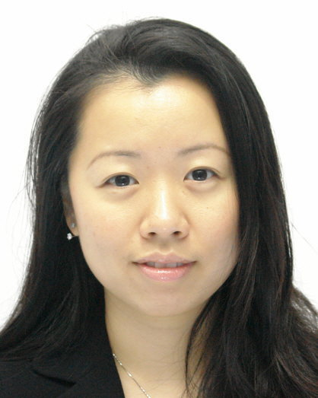
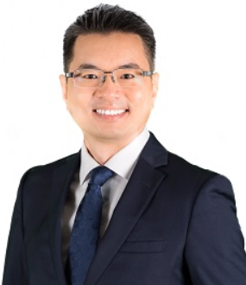
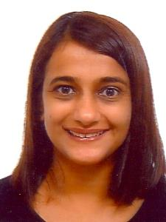
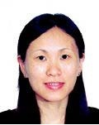
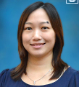
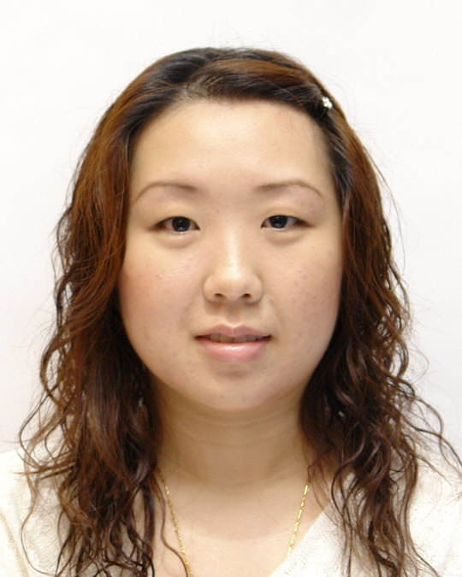
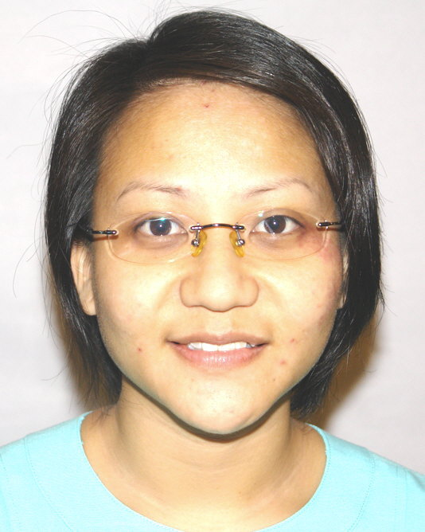
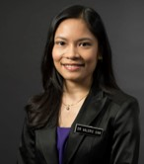
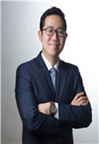
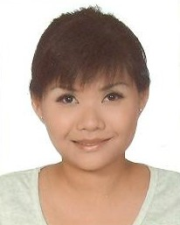
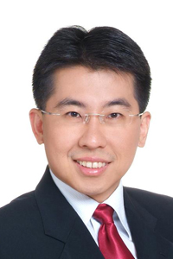
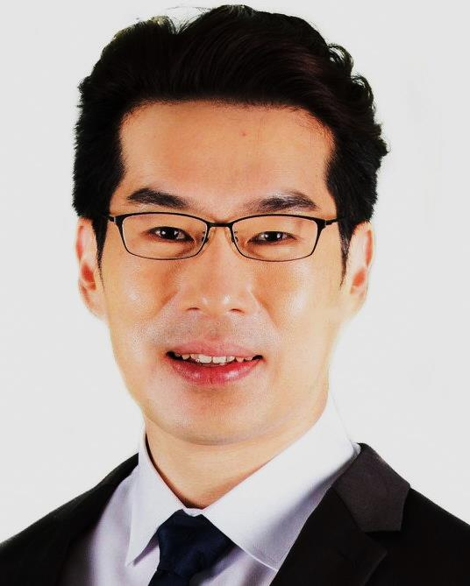
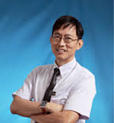
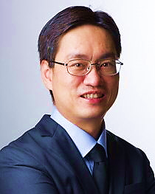
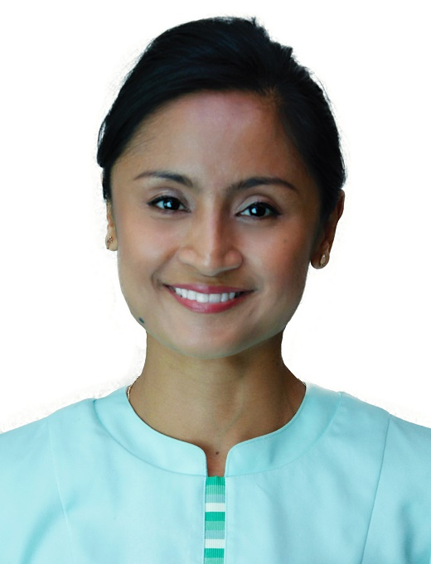
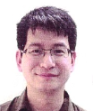
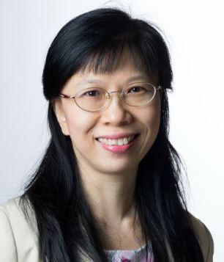
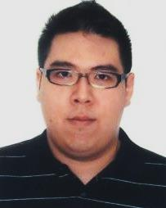
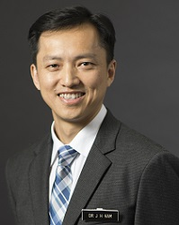
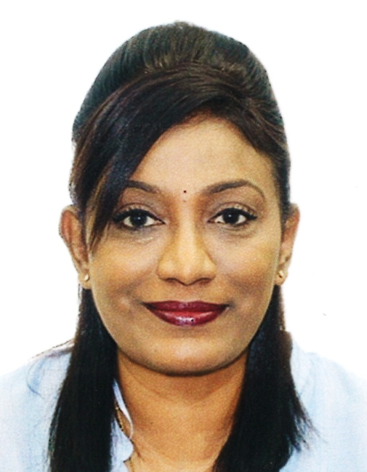
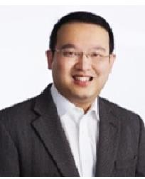
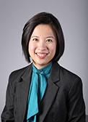
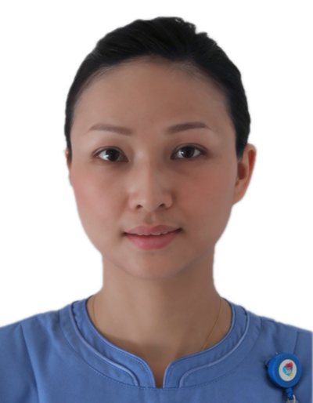
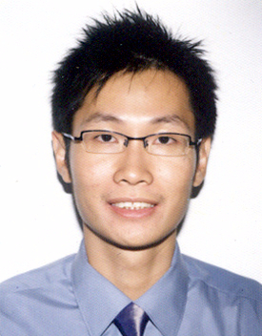
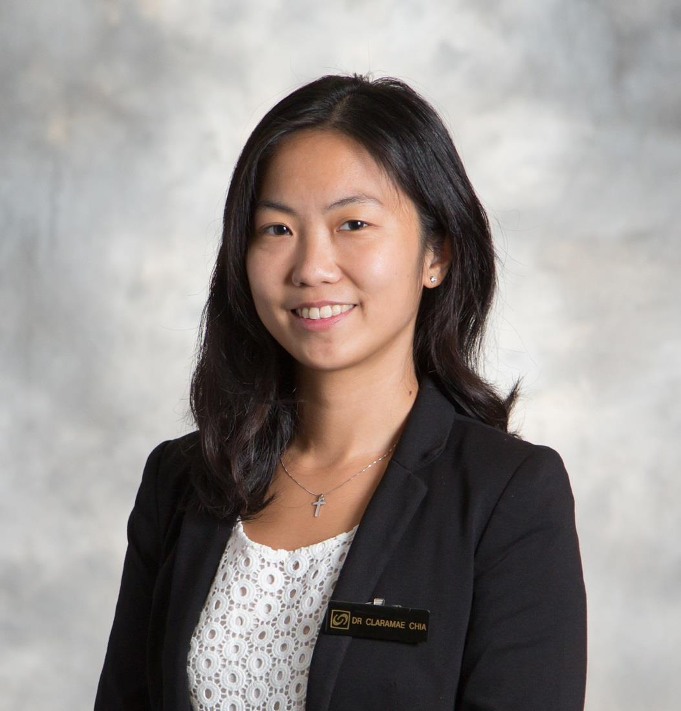
Surgery ACP Organisation Chart (updated as at 1 July 2021)
Academic Chair Assoc Prof Tan Hiang Khoon
Vice Chair
(Research)
Prof Pierce Chow
Vice Chair
(Undergraduate Education)
Assoc Prof Chong Tze Tec
Vice Chair
(Postgraduate Education)
Assoc Prof Caroline Ong
Vice Chair
(Clinical)
Assoc Prof Ong Hock Soo
Vice Chair
(Faculty Affairs &
Professional Development)
[Vacant]
Deputy Vice Chair Asst Prof Amos Loh
Deputy Vice Chairs
Assoc Prof Low Yee (KKH)
Prof Wong Wai Keong (SKH)
Assoc Prof Andrew Wong (CGH)
Deputy Vice Chair
Asst Prof Ong Lin Yin
AM Lead
Allied Health (SGH)
Asst Prof Ong Hwee Kuan
Surgical Technology and Innovation
Dir, Assoc Prof Yuen Heng Wai
NUS-YLL
(Undergraduate Education)
Dir, Asst Prof Teo Jin Yao
Residency
(General Surgery)
Dir, Asst Prof Teo Jin Yao
AM Lead
Allied Health (KKH)
Ms Parveen Kaur Sidhu
Colorectal Surgery (SGH, NCCS)
HOD, Assoc Prof Emile Tan
Breast Department (KKH)
HOD, Assoc Prof Lim Geok Hoon
AM Lead
Nursing (SGH)
Ms Jeraymin Yong
Outcomes Research & Database Registry
Dir, Prof Brian Goh
Residency
(Otolaryngology)
Dir, Asst Prof Neville Teo
General Surgery (SGH, NCCS)
[Vacant]
Otolaryngology (KKH)
HOD, Asst Prof Low Mei-Yi
Paediatric Surgery (KKH)
HOD, Asst Prof Ong Lin Yin
AM Lead
Nursing (SGH)
Ms Koh Sze Ling
Resident and Student
Research Mentorship Office
[Vacant]
HPB/Transplant Surgery (SGH, NCCS)
HOD, Assoc Prof Chan Chung Yip
Residency
(Urology)
Dir, Asst Prof Valerie Gan
Surgery (CGH)
Chief, Asst Prof Adrian Chiow
AM Lead
Nursing (SGH)
Ms Priscilla Chua Siew Huang
Otorhinolaryngology –
Head & Neck Surgery (SGH, NCCS)
HOD, Assoc Prof Toh Song Tar
Health Services Research
Co-Dir, Assoc Prof Emile Tan
Co-Dir (Vacant)
Otolaryngology (CGH)
Chief, Asst Prof Ian Loh
AM Lead
Nursing (SGH)
Ms Ang Shin Yuh
Residency
(Surgery-in-General)
Dir, Prof Alexander Chung
Urology (SGH, NCCS)
HOD, Assoc Prof Henry Ho
Urology (CGH)
Chief, Assoc Prof Terence Lim
AM Lead
Nursing (SGH)
Ms Fazila Aloweni
Upper GI/Bariatric Surgery (SGH, NCCS)
HOD, Asst Prof Jeremy Tan
Advanced Specialist
Training / Fellowship
Dir, Assoc Prof Benita Tan
Division of Breast Surgery (CGH)
HOD, Assoc Prof Tan Su-Ming
AM Lead
Nursing (SGH)
Mr Lim Cong En Julian
Vascular Surgery (SGH, NCCS)
HOD, Assoc Prof Chong Tze Tec
Surgery (SKH)
HOD, Asst Prof Kam Juinn Huar
Head & Neck Surgery (SGH, NCCS)
HOD, Prof Gopal Iyer
AM Lead
Nursing (SKH)
Ms Sumathi Sagayamary
Urology (SKH)
HOD, Asst Prof Lee Lui Shiong
Surgical Skills Training Continuum
Dir, Asst Prof Lim Chin Hong
Breast Surgery (SGH, NCCS)
Breast Centre (SDDC)
HOD, Assoc Prof Veronique Tan
AM Lead
Nursing (CGH)
Ms Wang Chun Mei
Otolaryngology (SKH)
HOD, Asst Prof Charn Tze Choong
Sarcoma, Peritoneal and Rare Tumours (SPRinT) (SGH, NCCS)
HOD, Assoc Prof Claramae Chia
Head & Neck Centre (SDDC)
HOD, Asst Prof Constance Teo

